Slide 1
Week 01

Slide 2
What is the World Wide Web?
A huge resource of information
Logically unified, but physically distributed
Logically unified: Any one from any where can access the information using a very simple scheme consisting of links & URLs
Physically distributed: The information is stored on Internet-connected computers that are spread all over the globe

Slide 3
Who is allowed to access the Web?
Any one and every one with a computer and a connection to the Internet
No nationalistic, ideological, racial, or religious restrictions
In Pakistan, Web is accessible from any city or town that has a internet available

Slide 4
The Web is unlike any previous human invention.
Because it is a world-wide resource, important to all of the people in the world.

Slide 5
How do I visit a Web page?
Turn your computer on
Connect to the internet through a modem or Local Area Network
Launch the browser (which in most cases, will be the Internet Explorer)
Type in the URL of the Web page that you want to visit

Slide 6
Browser
Browser is the tool that we use to access the content of the Web
Browser and the content of the Web have the same relationship as the TV has with cable programming
1993 - The 1st major browser “Mosaic” was developed at the National Center for Supercomputing Applications (NCSA) at the University of Illinois.
Initially handled text only, later graphics-viewing capability was added

Slide 7
What is a URL?
Uniform Resource Locator
The unique address assigned to each unique page on the Web

Slide 8
Examples
http://dawn.com
http://www.facebook.com
http://www.smeda.org.pk

Slide 9
Are there any access charges?
Most of the info on the Web is available for free
There is some for-payment content on the Web, which is generally paid with the help of a credit card

Slide 10
How do I navigate the Web?
You go from one Web page to another my clicking on a link
For example, here is my Web page

Slide 11
Links
The underlined pieces of text are called links
Each link is a gateway to another Web page
All you have to do is click on the link to go to the page corresponding to that link

Slide 12
What is secret behind the explosive growth of the Web?
Anarchy – any page is allowed to link to any other
There are no controls over who puts what on the Web
Everyone can put whatever they want to put on the Web – and they do!
DRAWBACKS:
  Inconsistent quality of pages
  Broken links

Slide 13
The most popular Web sites?
Microsoft – Most popular software developer’s Web site
Yahoo – Most popular multi-service Web site
Amazon – most popular shop on the Web
CNN – most popular news Web site
Google – most useful search engine

Slide 14
What is a Web site?
A collection of related documents available on the Web
The first portion of the URLs in the Web pages of a Web site is the same e.g.
  http://www.vu.edu.pk/
  http://vulms.vu.edu.pk/
  http://vulms.vu.edu.pk/
  Are the URLs of three distinct Web pages on a single Web site

Slide 15
What is a Web Search Engine?
Search engines continuously scan the Web and compile a list of all the Web pages that they find
The search engine with the largest such list (or index) is Google – with a list of over 2 billion Web pages and over 330 million images
We use the search engine by typing a “search key word” or “query” on its Web page. It looks for those keyword in its index, and displays a list of Web pages that contain that keyword

Slide 16
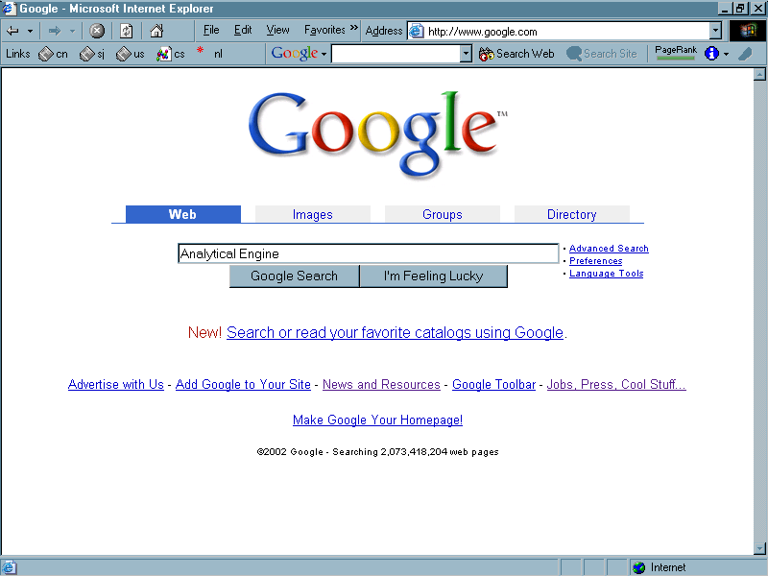

Slide 17
I know I can read off the Web. Am I allowed to put my stuff on the Web?
Yes. You just need to have a computer that is hooked up to the Internet.
You do not require anyone’s permission to put your Web page(s) on the Web
Your Web page will be available to all the millions of users that have access to the Internet the moment you place it on the Web

Slide 18
Am I allowed to put my stuff on the Web? (cont.)
Next week you’ll have the opportunity to do just that
You’ll learn how to develop your own Web page
And how to make it available on the Web

Slide 19
Internet ---- Web
?

Slide 20
The “Internet” and the “Web” are not the same
In fact, the “Web” is a service that runs over the “Internet”. In addition to the Web, there are many other services that run over the Internet.
Internet is like the network of roads in a city, whereas Web is a service like the Bus Service that run over those roads. Just like other services can use the roads (e.g. wagons), so can other services on the Internet (e.g. ftp). We’ll have more to say about this later in the course.
However, The following refer to the same thing:
  World Wide Web, Web, WWW

Slide 21
What info is available on the Web?
Information about almost every thing known to mankind and then some!
The info is in the form of:
  Text
  Graphics
  Animation
  Video
  Sound

Slide 22
Impact of the Web on:
        Computing
        Society
        Commerce

Slide 23
Impact of the Web on Computing
Every one wants to use the Web
That has encouraged the demand for computers
That, in turn, has reduced the cost of computing drastically
The computers are becoming easier to use because the target users are becoming less and less sophisticated
In the olden times only experts used computers; now my 4-year old knows things about the machine that I never did

Slide 24
Impact of the Web on Society
User friendly communication has become much more affordable – the global village is shrinking
Business persons can stay in touch with their businesses even without being there – for some, that has resulted in the destruction of their family life

Slide 25
Impact of the Web on Commerce
Huge impact
The moment I take my business to the Web, it becomes possible for my customers to find out about me without me being physically present in their city
Suddenly, I’m running a global business

Slide 26
Who invented the Web & Why?
Tim Berners Lee – British physicist
1989 – At the European Center for Nuclear Energy Research (CERN) in Geneva
He just wanted a way by which scientists could easily share documents over a computer network

Slide 27
The key weakness of the Web?
The Web (as it currently exists) was designed for human to read, not for computers to understand and manipulate meaningfully
Computers have a great problem in dealing with the current text and graphics based Web
Here is an example …

Slide 28
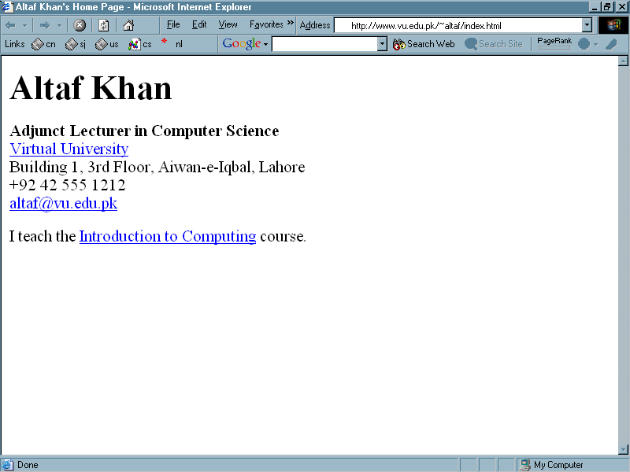

Slide 29
What’s the problem with this page?
You (a human) see this page and immediately understand what my name is
How would a computer know the same fact?
For that, the computer needs some help
Some help in form of a statement:
  Name=“Altaf Khan”
  Occupation=“Teaching”
  Employer=“Virtual University”
  And so on

Slide 30
The Future: The Semantic Web
What unique feature distinguishes the Web of today with the Semantic Web of tomorrow?
Whereas, today’s Web’s content is designed for humans to read; the Semantic Web’s content will be designed for computers to understand meaningfully
However, the Semantic Web is not a replacement but an extension of the present Web, in which information is given well defined meaning

Slide 31
The Semantic Web
Some progress is already being made for adding “Semantic Content” on to the Web, but a lot more will happen in the next 5 years
To find further info about this exciting development read Tim Berner Lee and his co-worker’s paper: “The Semantic Web” that is available on the Web as:
http://www.sciam.com/2001/0501issue/0501berners-lee.html

Slide 32
What have we learnt today?
What is the World Wide Web?
How does it work?
The impact of the Web on computing, society, and commerce

